Slide 1
Learn link
Guide Team Members Julith Jacob Aswin Jim Thuruthippilly Christin Jose Biju Johnson V Mathew Rohan Mannaraprayil

Slide 2
Problem Statement
Challenges
Finding a platform that integrates well and helps teams work together.
Existing solutions don't effectively facilitate communication, knowledge sharing, and meaningful discussions.
Missing Features
Seamless communication tools.
AI-driven insights for informed decision-making.
Intuitive design for easy use.
Consequences
Users struggle to organize their ideas efficiently.
Learning processes are not streamlined.
Need for a Solution
A comprehensive platform that boosts productivity.
A platform that fosters academic excellence through enhanced collaboration and resource sharing.

Slide 3
Solution Approach
Real-Time Collaboration and Communication
Content Sharing and Management
AI-Powered Tools
Voice calls for discussions, brainstorming, and team learning.
Voice communication, annotations, and co-editing to enhance teamwork.
Upload and share educational materials, question papers, and brainstorming artifacts.
Save content from brainstorming session
Summaries: Create concise summaries of documents.
Quiz Generation: Make quizzes for self-assessment.
Focus Area Extraction: Identify key questions and categorize them.

Slide 4
Modules
User Authentication
AI Integration
Collaboration
File Processing
User Login
User Registration
Google Login
Account Settings
AI-powered Document Summarization
Focus Area
Quiz Generation
Flash Cards
Live Cursor
Collaborative canvas
Voice Communication
State Updates
File Limit Enforcement
Duplicate Prevention
File Type Identification

Slide 5
Technology Stack
Front End
Back End
API Used
React js : React.js is a powerful JavaScript library used for building user interfaces.
Scan/cd : Frontend component Library
Node js : JavaScript runtime for server-side applications.
Express js : Web application framework for Node.js that simplifies server-side development by providing
robust features for building web applications.
Gemini API : AI-powered text and media processing. Auth0 : Auth0 enables secure user authentication and authorization

Slide 6
Implementation Details
User Authentication
1.Auth0 Integration:
Auth0Provider wraps the app for authentication.
Configured with domain, clientId, and redirect_uri from environment variables.
2. Session Management:
Sessions persist using localstorage.
3. Redirect Handling:
Redirects users to /dashboard after login.
Custom callback ensures proper navigation.
4.Error Handling:
Logs authentication errors for debugging.

Slide 7
Implementation Details
AI Integration Implementation
Purpose:
Enhances user experience with intelligent features.
2. Integration:
AI services accessed via APIs or libraries
3.Frontend:
React components interact with AI for real-time responses.
4.Optimization:
Asynchronous calls and caching for performance.
Collaboration
1.Real-Time Features:
Enables multiple users to interact or work together in real time (e.g.,Live cursor or Voice calls).

Slide 8
Implementation Details
2.Backend Integration:
Uses WebSockets, REST APIs, or third-party services for real-time data synchronization.
3.Frontend Interaction:
React components dynamically update the UI based on collaborative actions.
4.User Roles:
Implements role-based access control for managing permissions in collaborative environments.
File Processing
File Upload:
Users can upload files via a React-based UI.
Files are sent to the backend using APIs.

Slide 9
Implementation Details
2.Backend Handling:
Files are processed on the server
Supports PDFs.
3.Feedback to Users:
Real-time progress indicators for uploads.
Error messages for invalid files or processing failures.
4.Security:
Implements file size limits and type validation to prevent malicious uploads.

Slide 10
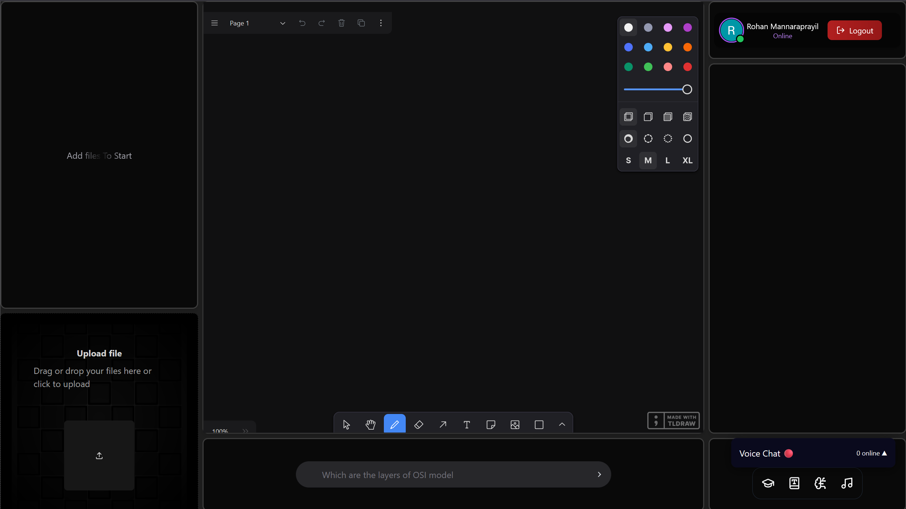
Screenshots
Img1:Dashboard

Slide 11
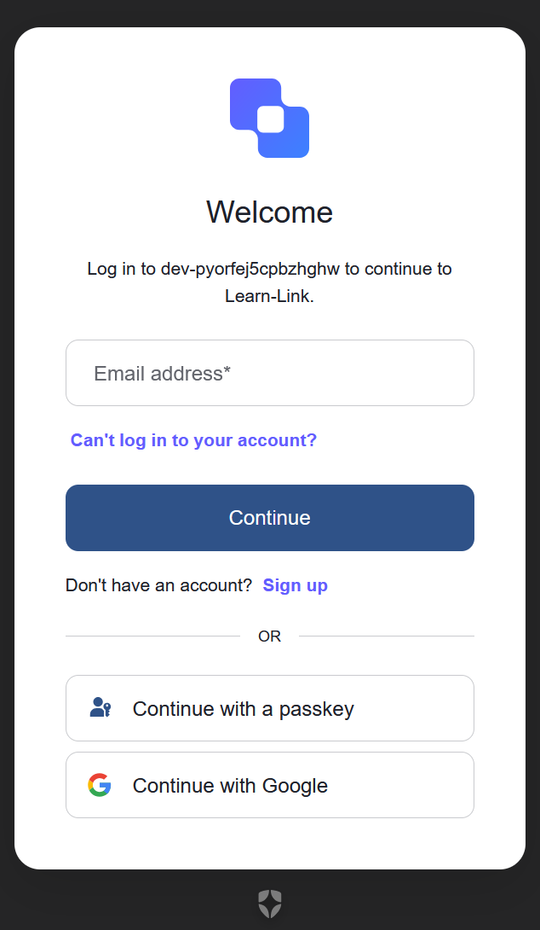
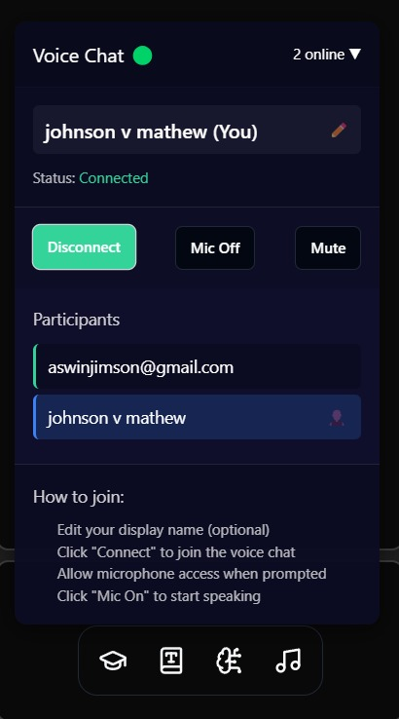
Screenshots
Img2:User Authentication
Img3:Voice Chat

Slide 12
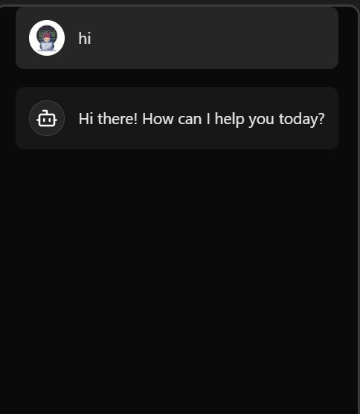

Screenshots
Img4:AI Integration
Img5: File processing

Slide 13
Conclusion
Learn-Link stands as a testament to the transformative power of technology in education.
By addressing key limitations of traditional learning such as collaboration, interactivity, and efficiency, Learn-Link has set a new standard for productive and engaging learning experiences.
Through its innovative use of real-time tools and AI, the desktop website not only provides users with a dynamic and collaborative platform to explore but also offers a glimpse into the future of learning.
The success of Learn-Link highlights the potential for technology to revolutionize education, offering a wide range of benefits that transcend traditional learning methods.
From enhanced teamwork and personalized insights to streamlined resources and secure access, this platform opens up new possibilities for learners. As web technologies continue to advance, the potential for innovative and transformative learning experiences will only continue to grow, making Learn-Link a pioneering example of the future of education.

Slide 14
References
Dillenbourg, P., Jarvela, S., Fischer, F. (2018). The evolution of research on collaborative learning. In International Handbook of the Learning Sciences (pp. 27-38). Routledge.
Chi, M. T. H., Wylie, R. (2014). The ICAP framework: Linking cognitive engagement to active learning outcomes. Educational Psychologist, 49(4), 219-243.
Schneider, B., Nebel, S., Beege, M., Rey, G. D. (2020). The cognitive-affective-social theory of learning in digital environments (CASTLE). Educational Psychology Review, 32, 1-29.
Hwang, G. J., Fu, Q. K. (2019). Trends in the use of artificial intelligence in computer-supported collaborative learning: A systematic review. British Journal of Educational Technology, 50(3), 990-1004.
Rose, C. P., Wang, Y. C., Cui, Z., Arastoopour, G., Steinkuehler, C. (2019). AI and collaborative learning: The state of the field. International Journal of Artificial Intelligence in Education, 29(3), 397-417.

Slide 15
Thank you

